Slide 1




Hypothesis Tests – Difference Test

Slide 2
Agenda
Difference test:
For mean-comparison: Independent t-test
Hypothesis testing
PA7 revision (optional) due this Friday

Slide 3
Hypothesis testing Comprising means for two groups – Independent T-test
Example: You want to compare if there is difference between male and female in terms of number of days eating breakfast in a week
Type of RQ: Difference RQ
Level of measurement of analysis variable: interval or ratio
Which statistical test?
Questionnaire quesitosn for the analysis variable:
Q1: What’s your gender? () Male () Female
Q2: How often do you eat breakfast per week? _
Male
X̅₁ = 3.93 times a week
n1 = 14
SD1 = 2.67
Female
X̅₂ = 5.06 times a week
n2 = 16
SD2 = 1.73

Slide 4
Formula and Intuition
difference in X_bar: ( X̅₁ – X̅₂ )
SE (standard error):√(SD1²/n₁ + SD2²/n₂ )
Critical value method:
t =( X̅₁ – X̅₂ ) / SE
* The larger the |t|, the higher the confidence that there is a difference in population average.
* make sure to take absolute value of t before comparing with t_critical
t_critical@90% = 1.64 , t_critical@95% = 1.96 , t_critical@99% = 2.58
(if n is large)

Slide 5
T critical value with degree of freedom
Look up the t table
Degree of freedom = (n₁ - 1) + (n₂ - 1) = 14-1 + 16-1 = 28
Confidence level@90%,95%, 99%. 1 - CI = alpha = 10%, 5%, and 1%
t_{critical@90%} = 1.7
If t > t_{critical} then you reject the null hypothesis (i.e., null = no difference), meaning the difference is big enough/ statistically significant

Slide 6
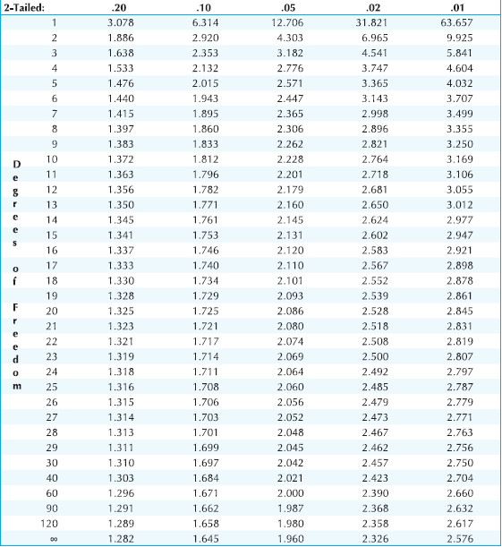
T distribution: degree of freedom confidence level

Slide 7
Critical value method
t =|( X̅₁ – X̅₂ ) / SE|
SE (standard error):√(SD₁²/n₁ + SD₂²/n₂ )
Sample mean difference = X̅₁ - X̅₂ = 3.93 - 5.06 = -1.13
Standard Error = Square root(02.67^2/14 + 1.73^2/16)
t = |( X̅₁ – X̅₂ ) / SE| = |-1.13/0.83| = 1.35
Hypothesis testing steps:
H0: μ1 – μ2 =0, Ha: μ1 – μ2 <> 0 (note: you can also write in English)
t = 1.35 NOT > tcritical@90% confidence, df = 28 = 1.7 Thus, we cannot reject the null hypothesis.
There is no enough evidence to say there is difference between male and female in terms of their frequency of eating breakfast in the population at 90% confidence level.

Slide 8
Hypothesis testing steps
Formula the null and alternative hypothesis. Null is always Statement of no difference. H0: μ1 – μ2 =0 , Ha: μ1 – μ2 <> 0 Note: µ is population mean but you use the sample mean X̅₁ - X̅₂ to infer the population mean.
Calculate using confidence interval or critical value method. Reject the null hypothesis that there is no difference if test statistics (t) is larger than the critical value (t critical)
Conclusion:
If we cannot reject the null hypothesis: there is not enough evidence to say there is a difference in the population average between male and female in terms of # of times eating breakfast at 90% confidence level.
If reject the null: we are 90% confident that there is a difference in population average between male and female in terms of # of times eating breakfast in a week.

Slide 9
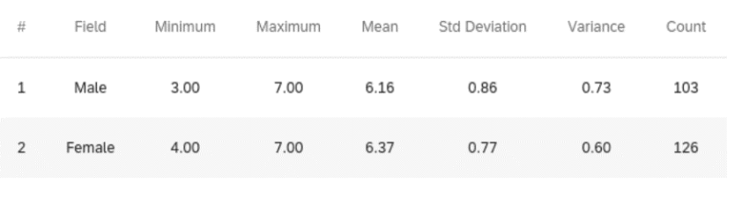
Practice question – Qualtrics example write out the three steps of hypothesis test
Do men and women differ in how satisfied they are with their gift shopping experiences?
Critical value method:
t =|( X̅₁ – X̅₂ ) / SE|
SE/standard error:√(SD1²/n₁ + SD2²/n₂ ) ; Df = n1-1 + n2 -1
t_{critical@90%} = ? hypothesis? t =? conclusion =?

Slide 10
T distribution: degree of freedom confidence interval

Slide 11
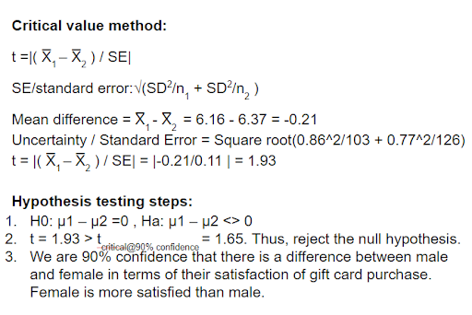
Critical value method
Notes:
95% confidence, critical value. 1.96 is 95% CI critical value. t < t-critical at 95% CI, → cannot reject the null. there is no enough evidence to say there is difference between male and female in terms satisfaction on gift card purchase at 95% confidence level.

Slide 12
t statistics vs. t critical value judgement rule
Since the t statistics that you calculated from the practice question above is 1.93, when the
t_critical@90% = 1.645 , thus t test statistics = 1.93 > t_critical@90%. You can reject the null hypothesis and claim a difference between the population means at the 90% confidence level.
when t_critical@95% = 1.96, thus t test statistics = 1.93 NOT > t_critical@95%. You can NOT reject the null hypothesis. You will claim there is NO difference between the population means at the 95% confidence level.
when t_critical@99% = 2.58, what’s your conclusion? thus t test statistics = 1.93 NOT > t_critical@99% (2.58). accept the null or There is no difference.
(any n larger than 120, you can use the last row in the t table or n is infinite)
Notes:
b) the hypothesized value is outside the confidence interval

Slide 13
What’s degree of freedom?
X + Y + Z = 10
How many variable can be changed? 3 variable – 1 = 2 degree of freedom
Thus, for linear n – 1 = 2
Notes:
b) the hypothesized value is outside the confidence interval

Slide 14
Agenda
Difference test:
For cross-tabulation: two-way chi-square
Second exam:
Practice questions ( no one-way chi-square test)
Next week
Extra credit PA

Slide 15

Hypothesis Testing Two-way Chi-square test
Example
Level of measurement of analysis variable: nominal or ordinal
Difference RQ: cross-tabulation analysis
Do students living on campus differ from those living off campus in their pizza preferences (Papa Johns, Shakespeare's, Gumby’s).
Questionnaire question:
Q1: Where do you live? _ on campus _ off campus
Q2: Which of the following is your most preferred pizza restaurant? (Select only one)
Papa Johns
Shakepeare’s
Gumby’s

Slide 16
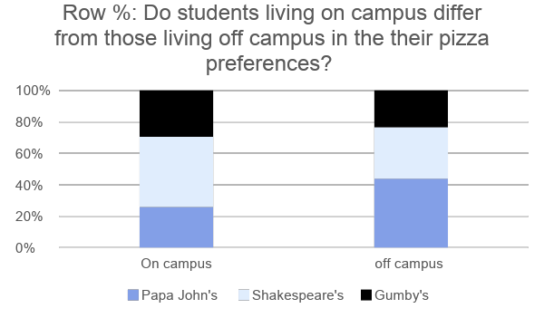
Visualization
Do students living on campus differ from those living off campus in their pizza preferences?
 | Papa John's | Shakespeare's | Gumby's | Total
On campus | 29 | 50 | 33 | 112
off campus | 43 | 32 | 23 | 98
Total | 72 | 82 | 56 | 210
Row %: divide each cell over its row total. E.g., 29/112 = 26% Do students living on campus differ from those living off campus in the their pizza preferences?
 | Papa John's | Shakespeare's | Gumby's | Total % Row
On campus | 26% | 45% | 29% | 100%
off campus | 44% | 33% | 23% | 100%
Notes:
n1 - 1 + n2 -1 x+y+? = 10

Slide 17
iClicker
Do students living on campus differ from those living off campus in their pizza preferences (in population)?
A – Yes
B – No
C – Not sure
Answer to the clicker question: not sure.
Do students living on campus differ from those living off campus in their pizza preferences?
 | Papa John's | Shakespeare's | Gumby's | Total
On campus | 29 | 50 | 33 | 112
off campus | 43 | 32 | 23 | 98
Total | 72 | 82 | 56 | 210
We need to do a statistical difference test. Otherwise, the difference in the sample may due to sample error and cannot reflect true differences in population
Intuition: bigger the difference between observed and expected, the more likely there is difference in population
Step1:
H0: There is no difference in pizza preference between on-campus and off-campus students
Ha: There is a difference in pizza preference between on-campus and off-campus students
Step2: calculate the test statistics for chi-square test
Confidence level, Degree of freedom, formula
Step3: draw conclusion

Slide 18


iClicker answer
Calculate the expected value is tricky here:
Expected value = Row total * Column total / Grand total
Do students living on campus differ from those living off campus in the their pizza preferences?
 |  | Papa John's | Shakespeare's | Gumby's | row Total
Observed | On campus | 29 | 50 | 33 | 112
Expected
Observed | off campus | 43 | 32 | 23 | 98
Expected
column Total |  | 72 | 82 | 56 | 210
O-E | On campus
 | off campus
(O - E)^2 | On campus
 | off campus
(O - E)^2 / E | On campus
 | off campus |  |  |  | 7.56
Sum all the (O-E)^2/E to get the test statistics
Notes:
Calculation procedure - clockwise:
72*112/210 = 38.4
112*82/210 = 43.73
56*112/210 = 29.87
56*98/210 = 26.13
82*98/210 = 38.27
72*112/210 = 33
O-E: on first cell
29-38.4 = -9.4
(O-E)^2 = 88.36
(O-E)^2/E = 88.36/38.4 = 2.3
Chi-square value test statistics:
2.30 + 0.90 + 0.33 + 2.63 + 1.03 + 0.38 = 7.56

Slide 19
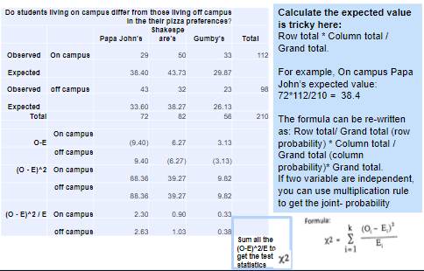
Answer

Slide 20
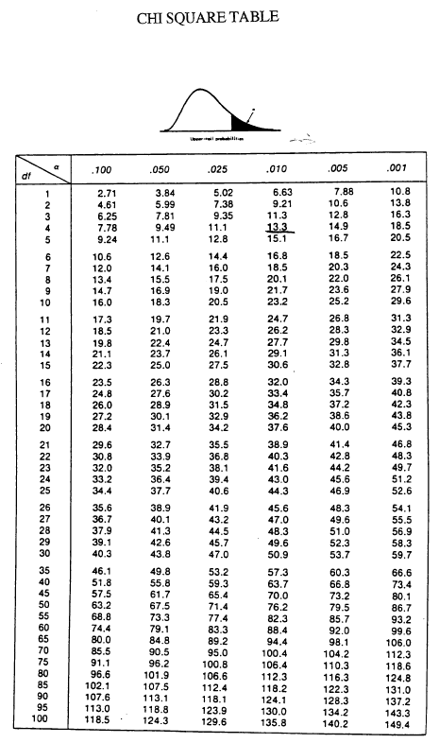
Chi-square test
Critical value of Chi-square table
1 – your confidence level is alpha . E.g.,
1 – 95% CI =
Df (degree of freedom) = (r-1) * (c-1)
= (2-1)*(3-1)= 2
Step 3: Conclusion:
We can reject the null hypo at 95% CI, since the test statistics (7.57) is the critical value of (5.99).
There is there is a in pizza preferences between on-campus and off-campus students at
Moreover,
On campus students prefer
, while off campus students tend to prefer Papa John’s. (Note: this is based on the row % calculated)

Slide 21
Visualization
Do students living on campus differ from those living off campus in the their pizza preferences?
 | Papa John's | Shakespeare's | Gumby's | Total
On campus | 29 | 50 | 33 | 112
off campus | 43 | 32 | 23 | 98
Total | 72 | 82 | 56 | 210
Row %: divide each cell over its row total. E.g., 29/112 = 26% Do students living on campus differ from those living off campus in the their pizza preferences?
 | Papa John's | Shakespeare's | Gumby's | Total % Row
On campus | 26% | 45% | 29% | 100%
off campus | 44% | 33% | 23% | 100%

Slide 23

Celebration: Math Function Dance

Slide 24
Recap - Difference test
For mean-comparison: Independent t-test
hypothesis testing 3 steps
Look up critical value in t table
Which group’s average is higher?
For cross-tabulation: two-way chi-square
calculate expected value
look up critical value in chi-square table
Which group’s percent is higher?

